Slide 1
Do Internal Factors or Market Conditions increase a counterparties likelihood of default?
James Rogers

Slide 2
Key Terms
Counterparty: The other party that participates in a financial transaction, and every transaction must have a counterparty in order for the transaction to go through.
Exposure: The measurement of the maximum potential loss to a lender if the borrower defaults on payment. It is a calculated risk to doing business as a bank.
PD (Probability of Default): Used by larger institutions to calculate their expected loss. A PD is assigned to a specific risk measure and represents the likelihood of default as a percentage.
Loss given default (LGD): The amount of money a bank or other financial institution loses when a borrower defaults on a loan, depicted as a percentage of total exposure at the time of default.
Recovery Rate: The extent to which principal and accrued interest on defaulted debt can be recovered, expressed as a percentage of face value.

Slide 3
Objectives
Download & Clean Data
https://www.listendata.com/2019/08/datasets-for-credit-risk-modeling.html
Join datasets and create a schema
Create credit risk model to identify why counterparties default on their obligations
Compare counterparties likelihood of repayment vs. internal factors
Compare counterparties likelihood of repayment vs. market conditions
Predict a counterparties PD based on the data
Compute the Recovery Rate relative to total exposure
Compute the LGD relative to exposure at the point of default
Create supporting code to manipulate data
Create visuals to highlight trends and findings

Slide 4
Technologies
SQL
Python
Microsoft Excel
Microsoft Power Platform
Azure

Slide 5
Data Set
Total Rows of data: 68,178
Total Counterparties: 5000
Lenders total exposure: $15,223,004,174
Average exposure per counterparty: $3,044,600
Average FICO score: 673.36
State or Territories represented: 52

Slide 6
Data Load and Merge

Slide 7
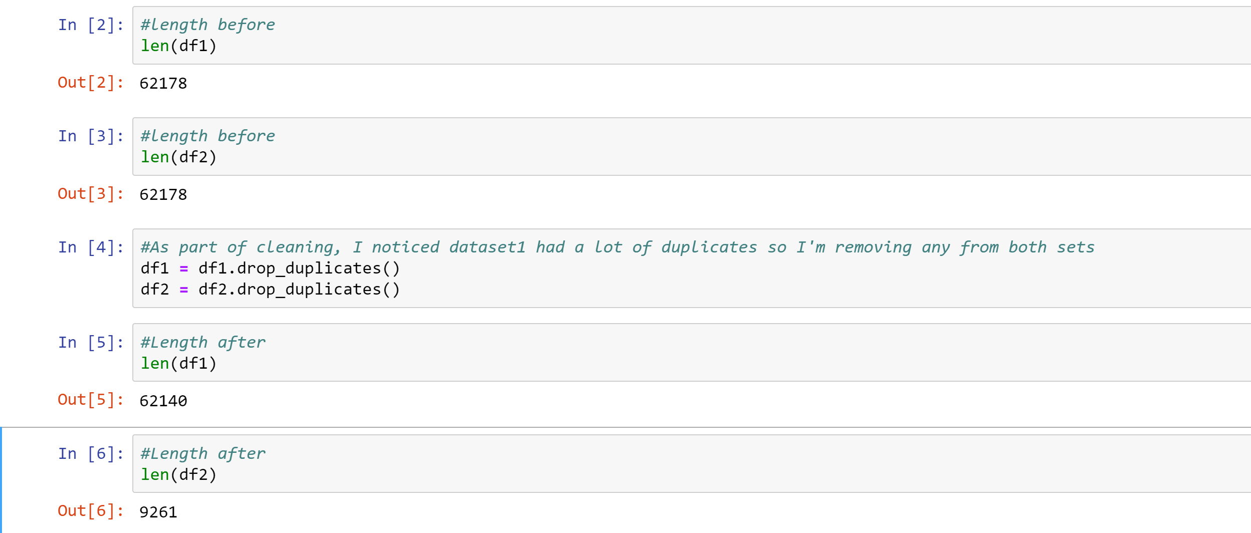
Removing Duplicates

Slide 8
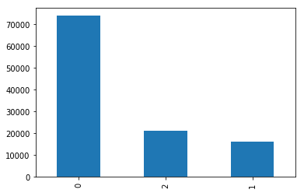
count = main_df["status_time"].value_counts() count count.plot(kind="bar")

Slide 9
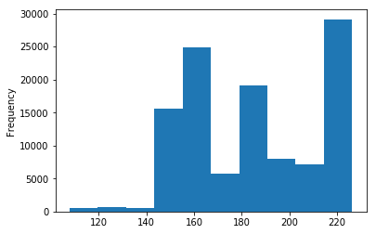
main_df["hpi_time"].plot(kind="hist")

Slide 10
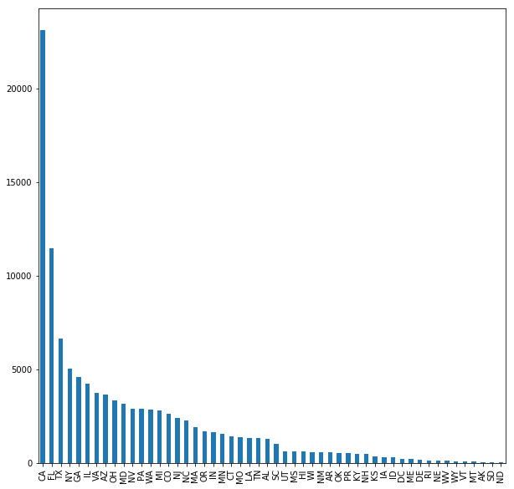
count = main_df["state_orig_time"].value_counts() count count.plot(kind="bar", figsize=(10,10))

